Slide 1
Project 6: NATURE INSPIRED PAINTING
mark making with objects from nature or objects found in your own home

Slide 2
Create your own unique painting
At home
Find ‘any’ items, like; sponges, foil, fork, old toothbrush, cabbage leaves, pasta and orange peel. Use poster paints or watered down acrylic paints to make different marks to create a unique painting.
In nature
Find ‘any’ items, like; leaves, twigs, feathers, flowers and stones. Use them with paints to make different marks to create a unique painting.

Slide 3
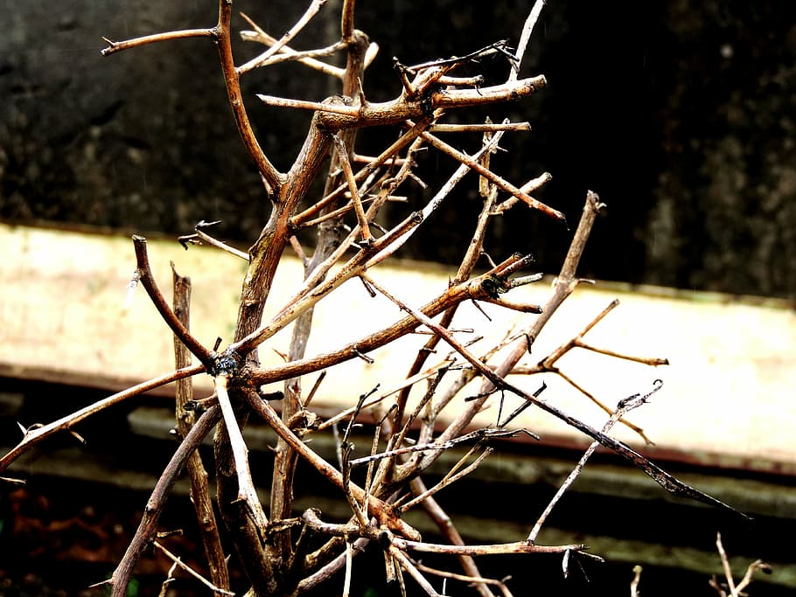
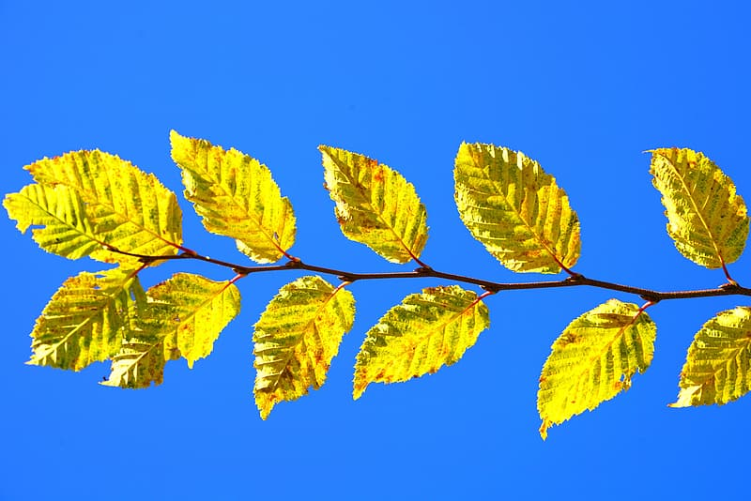
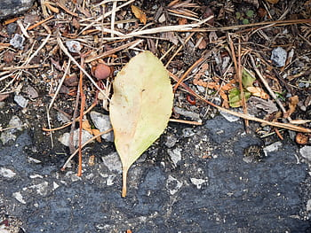
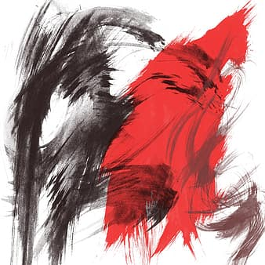
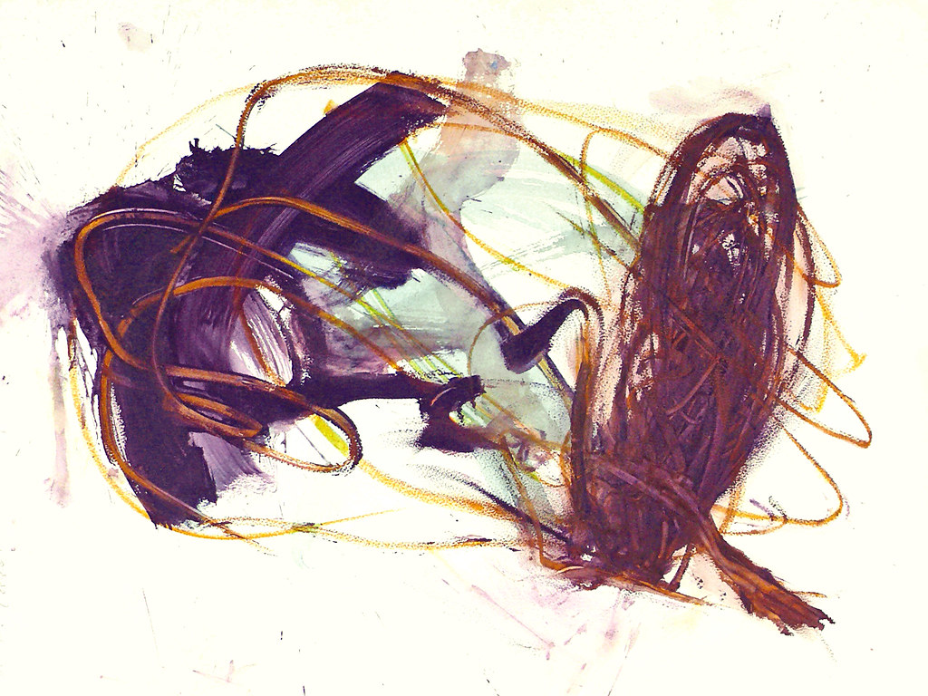
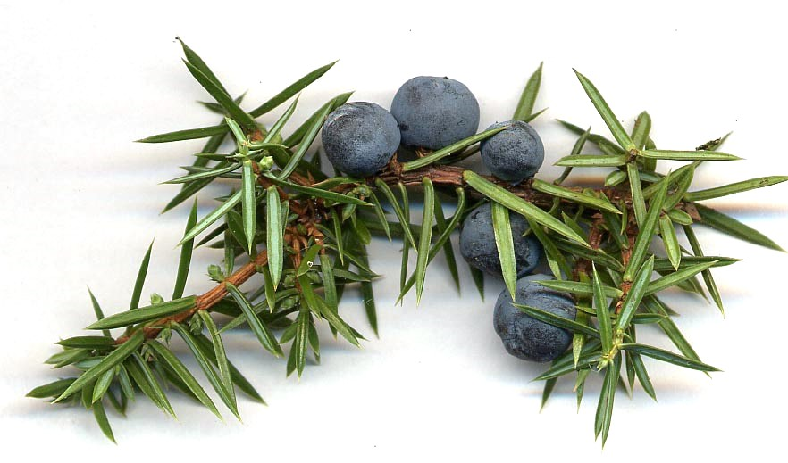
Hear are some objects from nature you can paint with

Slide 4
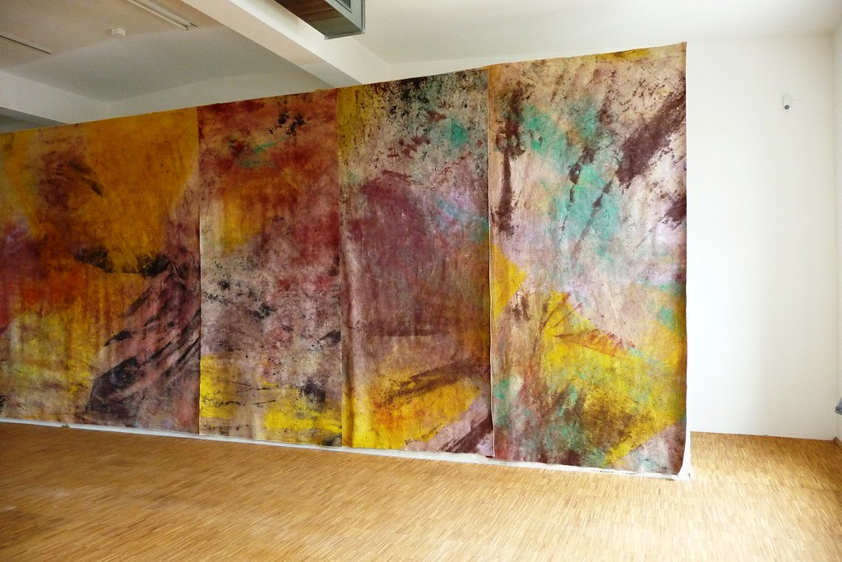
Watch this You tube video For Inspiration
Artist Jessica Warboys – Sea Paintings on location
https://www.youtube.com/watch?v=arQJ0F1l6lI

